Slide 1
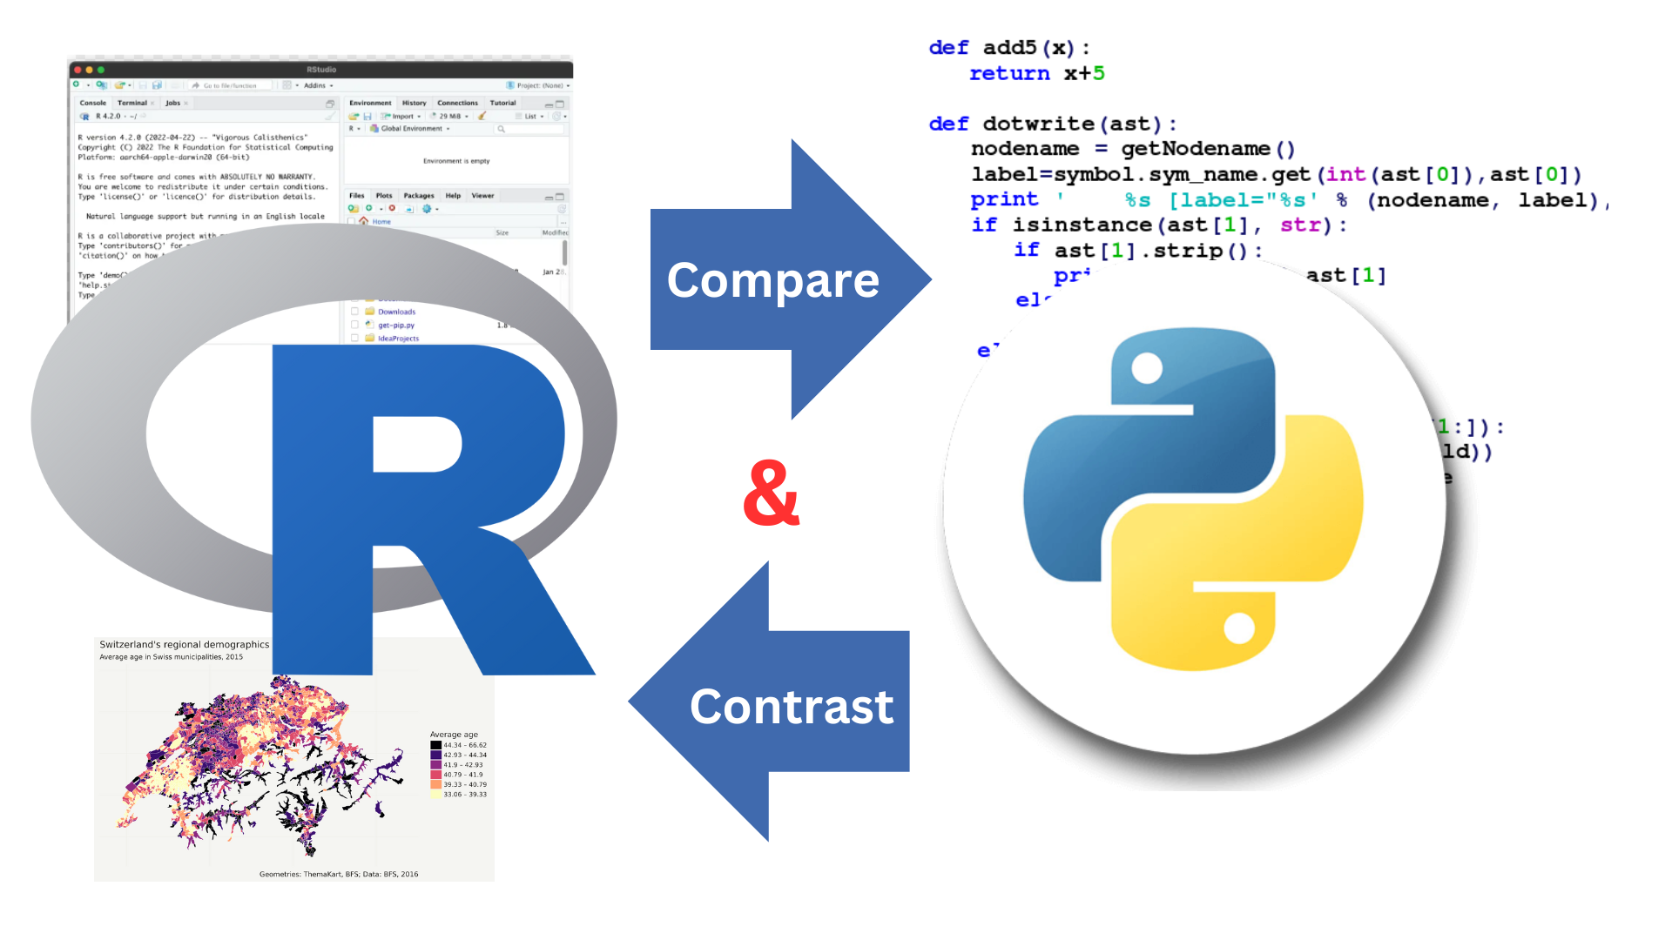

Slide 2

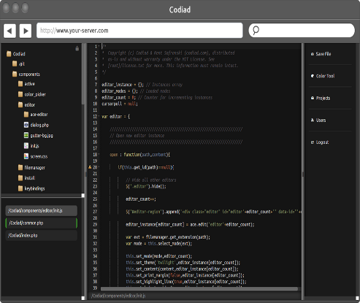
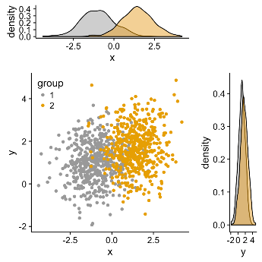


R / PYTHON
Adaptability | Visualization | IDE | Statistical Analysis | Processing Time

Slide 3
Adaptability
Python | R
Python could be considered easier to learn, though statisticians often feel that this language focuses on seemingly unimportant things. | R’s coding could require a learning period

Slide 4
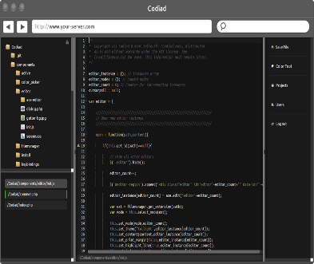
IDE
Python | R
Python is Free to download. It is open to the public and has a vibrant community. | R is free to download. As R is open-source and open to the public, it has gathered a vibrant community.
Jupyter notebook: web-based interactive development | Rstudio- interface is organized so that the user can view graphs, data tables, R code, and output
Spyder- specifically for scientific programming

Slide 5



Slide 6
Visualization
Python | R
Not as incredibly attractive to other languages but visuals are still useful for analysis | Make some incredibly attractive, detailed visuals that will blow someone away Great, if you are planning to publish your visuals to the public

Slide 8
Statistical Analysis
Python | R
Can do a lot of analysis and great for identifying trends but would need to use more code as compared to R’s premade functions | Can do a lot of analysis and great for identifying trends. Latest methods would be available before most languages in CRAN

Slide 10
Processing Time
Python | R
Handle huge size high-level language renders data at a much higher speed. | Handle huge size low-level language, which means longer codes and more time for processing. You can find packages in the community that allow a developer to improve the speed.

Slide 12



